Slide 1
Flexbox Review

Slide 2
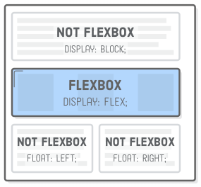
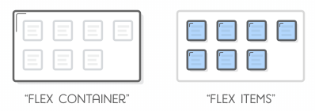
Flexboxes
Flexbox gives us complete control over the alignment, direction, order, and size of our boxes.
Flexbox uses two types of boxes “flex containers” and “flex items”.
The job of a flex container is to group a bunch of flex items together and define how they’re positioned.
The main purpose of flex items are to let their container know how many things it needs to position.
display:flex; enables the flexbox layout mode

Slide 3
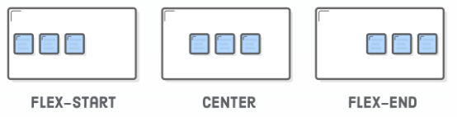
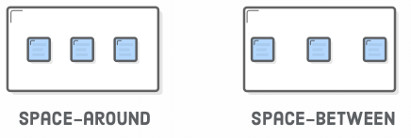
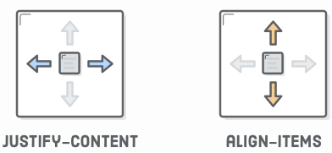
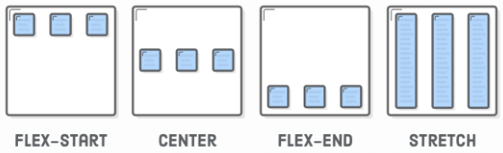
Positioning Items
Justify-Content
Align-Items
Center
Flex-start
Flex-end
Space-around
Space-between
center
flex-start (top)
flex-end (bottom)
Stretch (Same height as container)

Slide 4
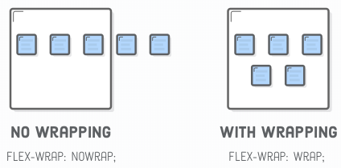
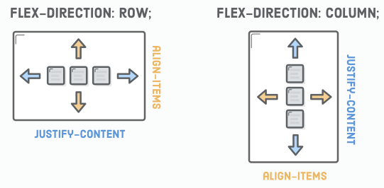
Flex Properties
Flexbox is its ability to transform rows into columns.
When you rotate the direction of a container, you also rotate the direction of the justify-content property.
flex-wrap: wrap; forces items that don’t fit to get bumped down to the next row

Slide 5
Summary
Use display: flex; to create a flex container.
Use justify-content to define the horizontal alignment of items.
Use align-items to define the vertical alignment of items.
Use flex-direction if you need columns instead of rows.
Use the row-reverse or column-reverse values to flip item order.
Use order to customize the order of individual elements.
Use align-self to vertically align individual items.
Use flex to create flexible boxes that can stretch and shrink.

Slide 6
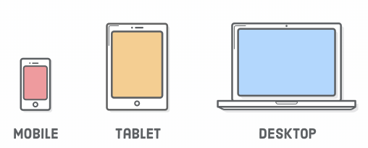
Responsive Design
Week 26 Day 1

Slide 7
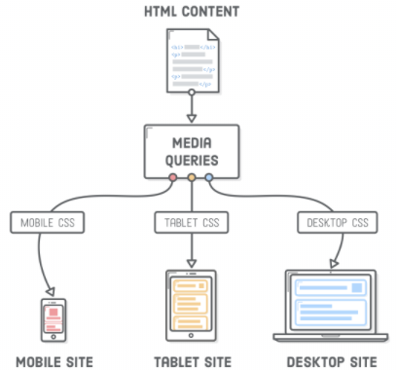
What is Responsive Design
“Responsive design” refers to the idea that your website should display equally well in everything from widescreen monitors to mobile phones.
Responsive design is accomplished through CSS “media queries”.
Think of media queries as a way to conditionally apply CSS rules. They tell the browser that it should ignore or apply certain rules depending on the user’s device.
Media queries let us present the same HTML content as distinct CSS layouts.
So, instead of maintaining one website for smartphones and an entirely unrelated site for laptops/desktops, we can use the same HTML markup (and web server) for both of them.
Notes:
After slide, have students open up Atom and create a new file named responsive.html.

Slide 8
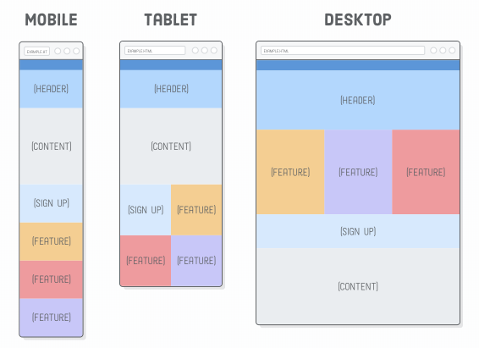
Setup
Download the GDWD_W26_D2.zip file from canvas
Open both the HTML and CSS files in “Atom”
We will be creating the HTML page on the right.

Slide 9
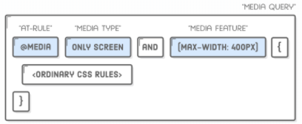
Media Queries
Media queries always begin with the @media “at-rule” followed by some kind of conditional statement, and then some curly braces.
Inside the curly braces, you put a bunch of ordinary CSS rules.
The browser only pays attention to those rules if the condition is met.
The only screen “media type” means that the contained styles should only be applied to devices with screens.
The min-width and max-width parts are called “media features”, and they specify the device dimensions you’re targeting.

Slide 10
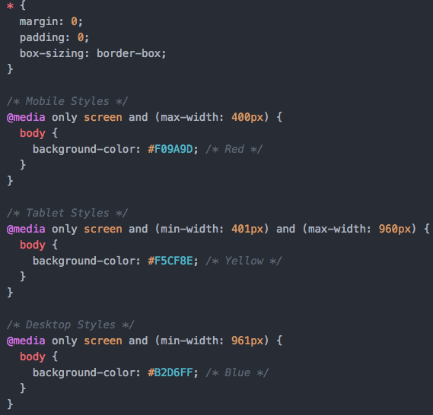
Add Media Queries
Add the following code into the responsive.css file.

Slide 11
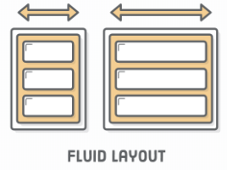
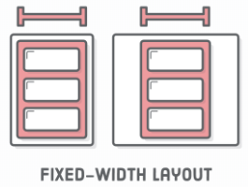
A few notes on design
In the real world, it’s up to the web designer to supply developers with the wireframe mockups.
Your job as a developer is to implement the individual layouts using media queries to separate out the various CSS rules that apply to each one.
There are two concepts that you must understand as a developer:
A “fluid” layout is one that stretches and shrinks to fill the width of the screen.
A “fixed-width” layout is the opposite: it has the same width regardless of the screen dimensions.
Our example will have the mobile and tablet versions are fluid, and the desktop version is fixed-width.

Slide 12
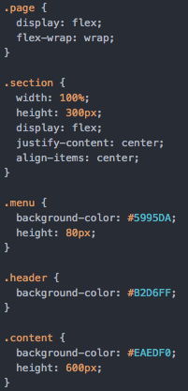
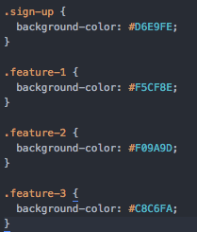
Mobile first development
Add the following code to the CSS file.

Slide 13

Mobile first development cont….
If you make the browser window narrow, you'll see that this gives us our entire mobile layout. No media queries required!
That’s why it’s called “mobile-first”—the mobile version doesn’t require any special handling.
Also notice that flex-wrap property in the containing .page div. This will make it very easy to implement our tablet and desktop layouts.
By keeping these base styles outside of the media queries, we’re able to override and add on to them as we implement our specific layouts.

Slide 14
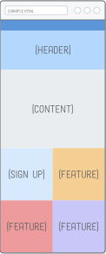
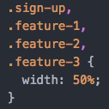
Tablet Layout
On to the tablet layout. The only difference between the mobile and tablet mockups is that the Sign Up and Feature sections form a 2×2 grid instead of a single column.
Flexbox makes this real easy. Simply adjust the widths of the flex items to be half the screen and flex-wrap will take care of the rest.
Again, it doesn’t matter what the exact width of the screen is: this layout will fluidly respond to any width in the media query’s range.
Add the code to the left in the CSS file, under the /* Tablet Styles */ Media query.

Slide 15
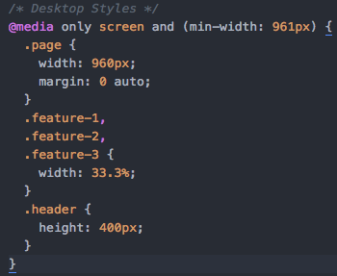
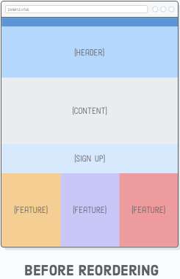
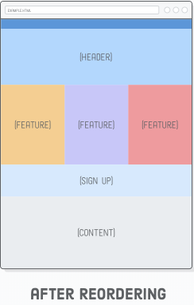
Desktop layout
When desktop layout comes in. We don’t want our web page to expand endlessly, so we’re going to give it a fixed width and center it with auto margins.
This gives us the correct widths for everything, and we have more real estate to play with.
.sign-up { height: 200px; order: 1; }
.content { order: 2; }

Slide 16
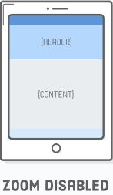
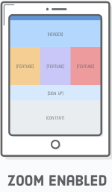
Disabling Viewport Zooming
Before responsive design was a thing, mobile devices only had a desktop layout to work with.
To cope with this, they zoomed out to fit the entire desktop layout into the width of the screen, letting the user interact with it by zooming in when necessary.
This default behavior will prevent mobile devices from using our mobile layout. To disable it, add the following element to the <head> of our document.
Notes:
This default behavior will prevent mobile devices from using our mobile layout. To disable it, add the following element to the <head> of our document.

Slide 17
Summary
Believe it or not, that’s actually all you need to know to create responsive websites. If we boil it down, we’re really only concerned with three things:
The responsive design (the mockups for each layout)
CSS rules for implementing each of those layouts
Media queries for conditionally applying those CSS rules

